Slide 1
Making the Most of Query Store in the Real World
Jeff Iannucci
He/Him
Senior Consultant
Straight Path Solutions

Slide 2
Solving Real World SQL Server Problems Learning Pathway
Wednesday
Unlocking the Power of WhoIsActive – Jeff Iannucci
Is Storage the Root Cause of Your Performance Woes… or Not? – Andy Yun
Thursday
Mastering Dynamic SQL – Deborah Melkin
Making the Most of Query Store in the Real World – Jeff Iannucci
Friday
Conquering the Monster Proc – How to Combat Legacy Code – Deborah Melkin
Notes:
Jeff Iannucci - Unlocking the Power of WhoIsActive
Andy Yun – Is Storage the Root Cause of Your Performance Woes… or Not?
Deborah Melkin – Mastering Dynamic SQL
Jeff Iannucci – Making the Most of Query Store in the Real World
Deborah Melkin – Conquering the Monster Proc – How to Combat Legacy Code

Slide 3

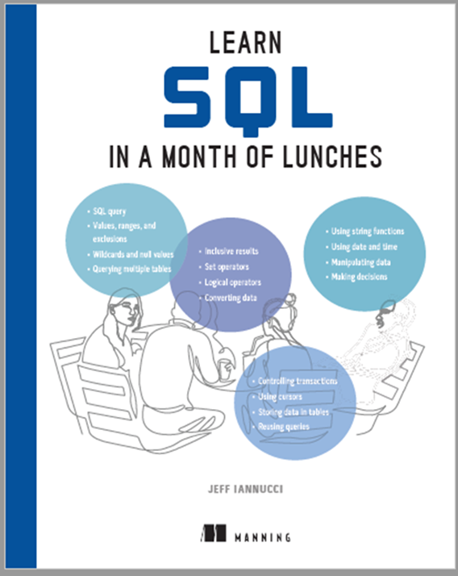


Who in the world is Jeff Iannucci?
Consultant at Straight Path Solutions
Content Author at Pluralsight
Author of “Learn SQL in a Month of Lunches”

Slide 4








A word of thanks to these folks
Conor Cunningham
Erik Darling
Grant Fritchey
Tara Kizer
Kendra Little
Brent Ozar
Paul Randal
Erin Stellato

Slide 5
Has this been your experience?
Query Store made performance worse
Query Store unexpectedly went READ_ONLY
Forced query plans didn’t always get used
Can we solve any REAL problems with this thing?
Notes:
Query Store made crash recovery take longer

Slide 6

YES, WE CAN!!!

Slide 7
“Real world” solutions
Ways to use Query Store beyond forcing plans
Considerations for defaults and “best practices”
Queries and free, community-supported tools
Common problems you can solve

Slide 8

Setting up Query Store

Slide 9
What defaults to change…maybe
MAX_STORAGE_SIZE_MB
MAX_PLANS_PER_QUERY
STALE_QUERY_THRESHOLD_DAYS
QUERY_CAPTURE_MODE

Slide 10
CUSTOM QUERY_CAPTURE_MODE
QUERY_CAPTURE_POLICY
EXECUTION_COUNT
TOTAL_EXECUTION_CPU_TIME_MS
(Start with high values)

Slide 11
What defaults to leave alone
DATA_FLUSH_INTERVAL_SECONDS
INTERVAL_LENGTH_MINUTES
SIZE_BASED_CLEANUP_MODE
WAIT_STATS_CAPTURE_MODE

Slide 12
Trace flags
Query Store uses in-memory tables
TF 7752 – allows queries to execute while QS loads into memory (SQL Server 2016 & 2017 only)
TF 7745 – bypasses writing to disk at shutdown, losing unflushed data (all versions)

Slide 13
dba-tools (PowerShell)
Get-DbaDbQueryStoreOption
Set-DbaDbQueryStoreOption
Copy-DbaDbQueryStoreOption
Test-DbaDbQueryStore

Slide 14
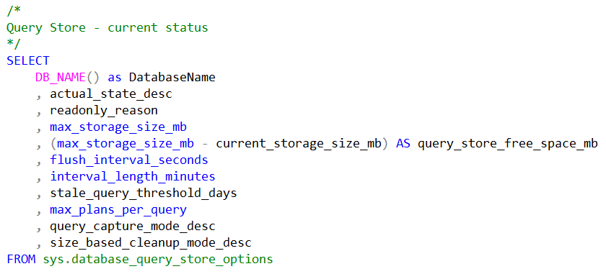
You should get a job (for monitoring)

Slide 15

Tools you can use

Slide 16
SSMS built-in reports
Top Resource Consuming Queries
Queries With Forced Plans
Tracked Queries

Slide 17
SSMS built-in reports
Top Resource Consuming Queries
Queries With Forced Plans
Tracked Queries

Slide 18
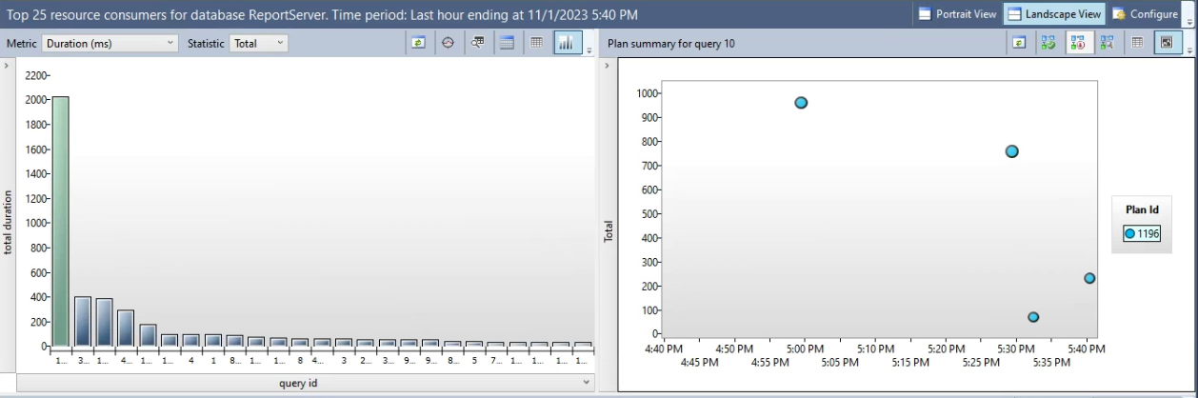
Top Resource Consuming Queries

Slide 19
Defaults are…
Top 25
Last hour
Total and Duration (2 separate defaults)
Cute and colorful circles (squares and triangles too)

Slide 20
What is the real problem?
CPU usage
Memory consumption
I/O (reads and/or writes)
Total, Average, Maximum

Slide 21
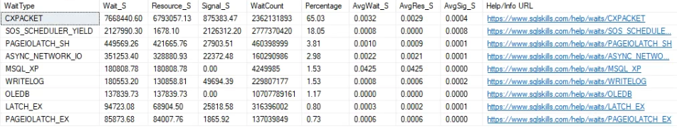
Paul Randal’s Wait Stats
https://www.sqlskills.com/blogs/paul/wait-statistics-or-please-tell-me-where-it-hurts/

Slide 22
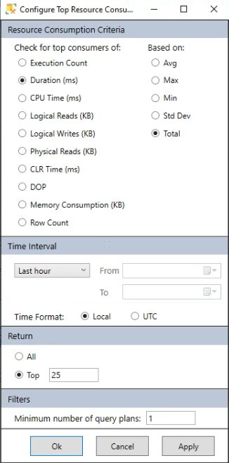
Top Resource Consuming Queries

Slide 23
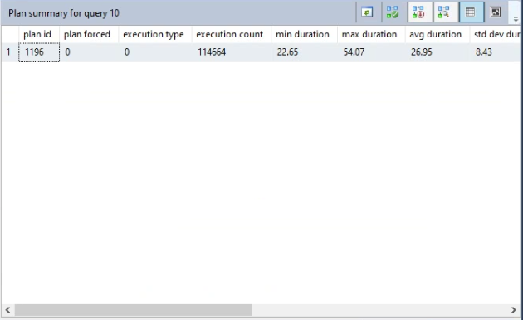
Top Resource Consuming Queries

Slide 24
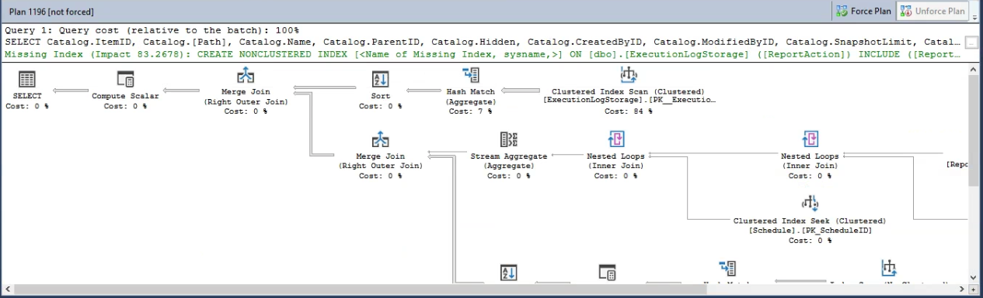
Top Resource Consuming Queries

Slide 25
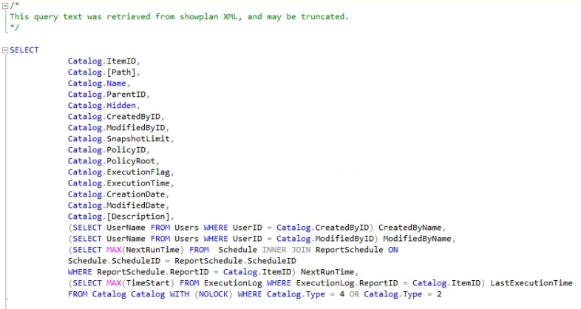
Top Resource Consuming Queries

Slide 26
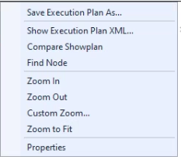
Top Resource Consuming Queries

Slide 27
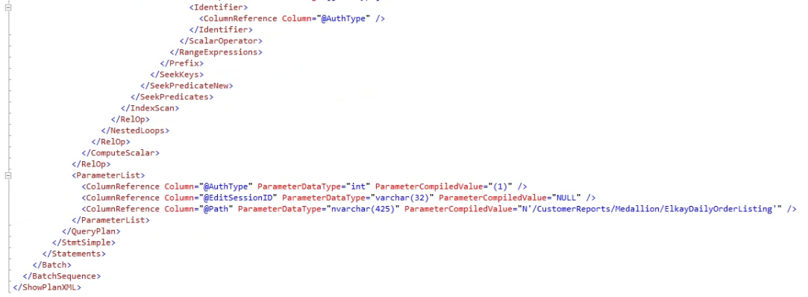
Top Resource Consuming Queries
WARNING: This could contain PII

Slide 28
SSMS built-in reports
Top Resource Consuming Queries
Queries With Forced Plans
Tracked Queries

Slide 29

Forced plans are rarely a long-term solution

Slide 30
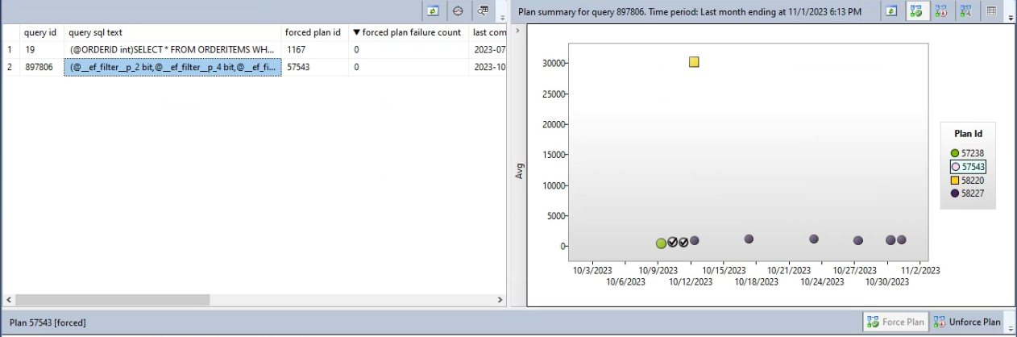
Queries With Forced Plans

Slide 31
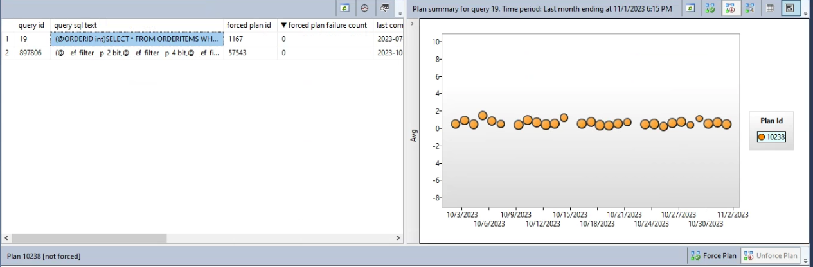
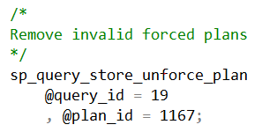
Queries With Forced Plans

Slide 32
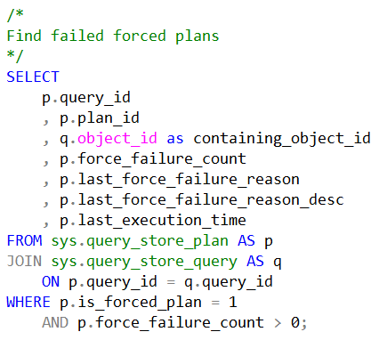
Failed forced plans

Slide 33
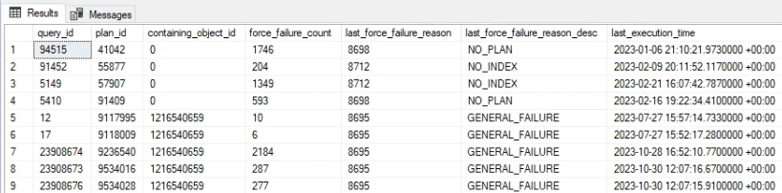
Failed forced plans

Slide 34
But…what’s the deal here?

Slide 35
“Morally equivalent plans”
Query Store has some flexibility
Not a bug, but a feature
Don’t show as failures
Forced plans are rarely a long-term solution

Slide 36
SSMS built-in reports
Top Resource Consuming Queries
Queries With Forced Plans
Tracked Queries

Slide 37
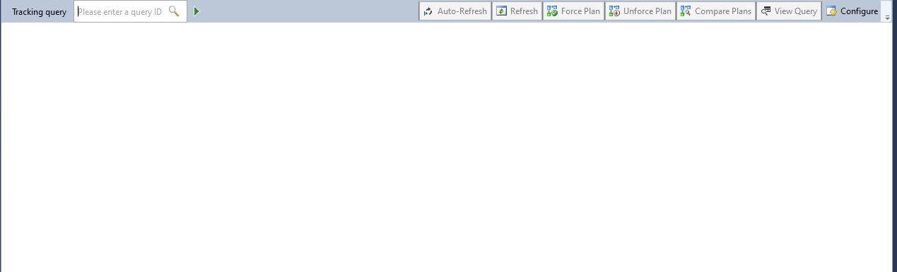
Tracked Queries

Slide 38
Tracked Queries
Shows performance of one specific query_id
Can compare plans
Use “Auto-Update” to track in real time

Slide 39
Find queries (query_id) by…
Object name (stored procedure/function/trigger)
String of characters
Time of execution

Slide 40
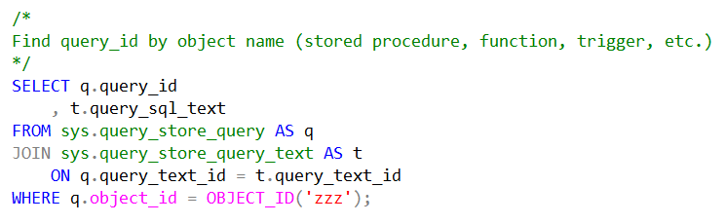
…by object name

Slide 41
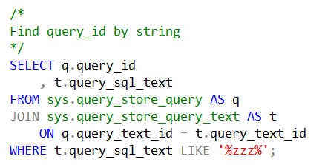
…by string

Slide 42
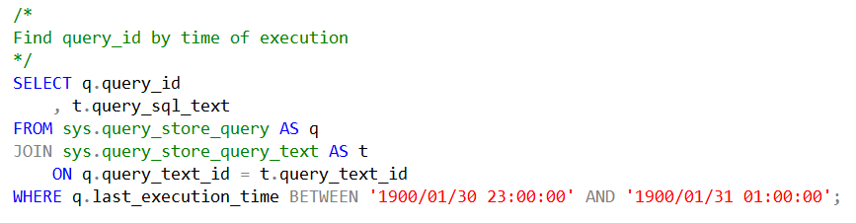
…by time of execution

Slide 43
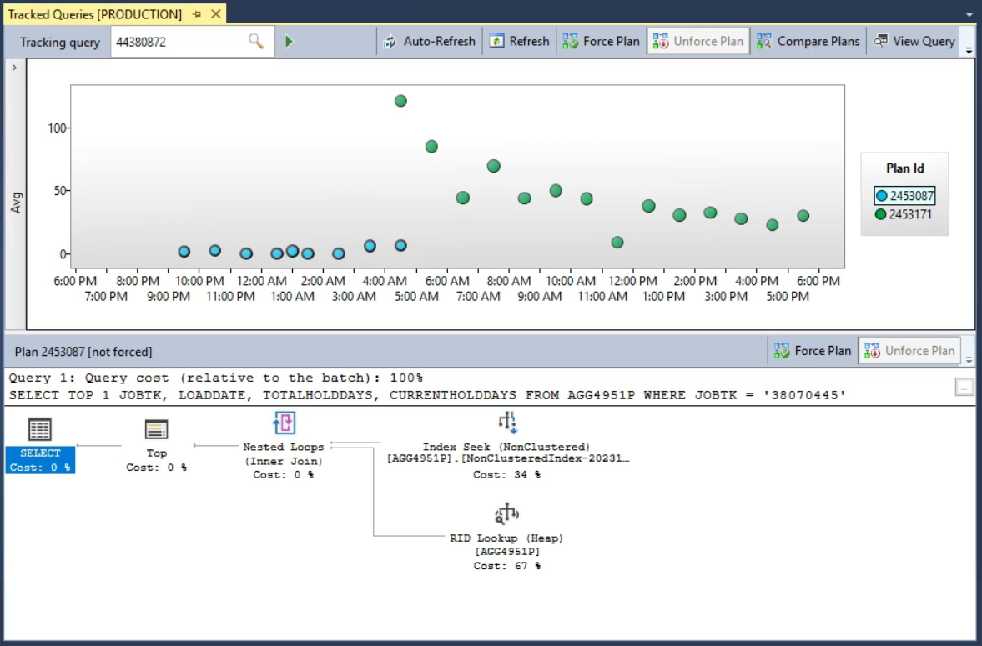
Tracked Queries

Slide 44
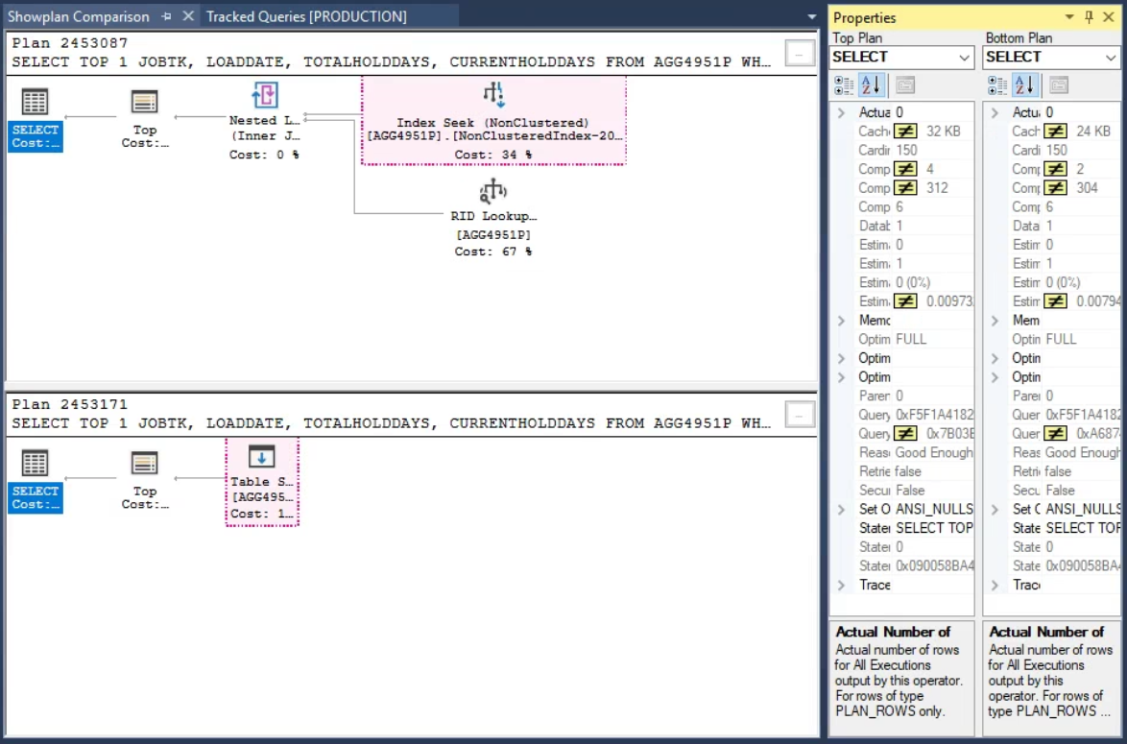
Tracked Queries - Comparison

Slide 45
sp_BlitzQueryStore
Prioritized listing of potential issues
Grouped by findings (“Worst Avg CPU”, etc..)
Better if you don’t know where to start
https://github.com/BrentOzarULTD/SQL-Server-First-Responder-Kit

Slide 46
sp_QuickieStore
Choose a metric (CPU, reads, writes, memory…)
Returns query text by default
Faster if you know what you’re looking for
https://github.com/erikdarlingdata/DarlingData/tree/main/sp_QuickieStore

Slide 47

Common problems you can solve

Slide 48
Testing index changes
Missing index requests shown in plans
Review existing indexes before adding
Unforce plans if adding/modifying indexes

Slide 49
Reducing upgrade pains
Upgrade to higher version of SQL Server
…but don’t raise the Compatibility Level
If performance is stable, raise the compatibility level
Use Query Store for analysis and regression fixes

Slide 50
Deadlocks
You can capture deadlocks with extended events
Query Store can give you more info
Use sys.query_store_runtime_stats
WHERE execution_type = 4

Slide 51
What do those shapes mean?
Successful query execution (0)
Aborted query (3)
Error during execution (4)

Slide 52
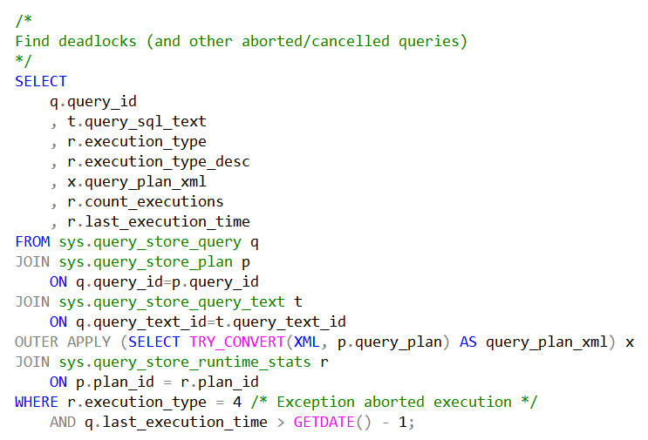
Deadlocks

Slide 53
Deadlocks
WARNING: this data is still aggregated
Compare deadlocks using sql_text
Review execution plans for objects locked in deadlocks
Use Tracked Queries report

Slide 54
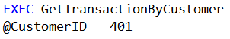
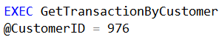
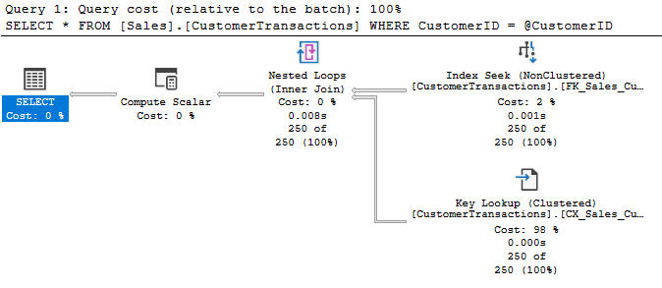
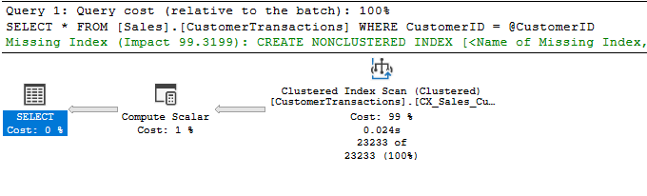
Parameter Sniffing
Different plans, different performance

Slide 55
What about FORCE_LAST_GOOD_PLAN?
Automatically force a better plan when found
Can still choose a “bad” plan
Can take hours to automatically revert

Slide 56
Parameter sniffing
Query sys.dm_db_tuning_recommendations
Insert JSON data from Details column into a table
Create a job that queries the table
Set job to “fail” when regressions occur

Slide 57
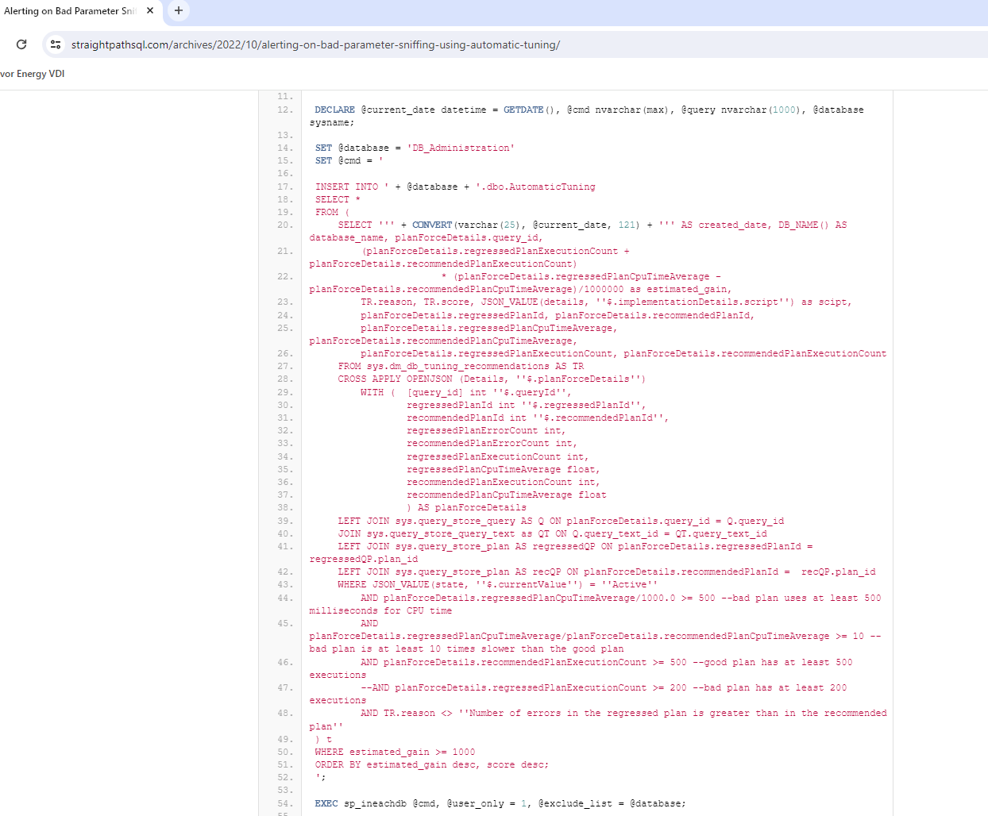

Slide 59
What happens next?
https://rb.gy/p1bme2

Slide 60
It’s demo time!

Slide 61

Let’s review what we have learned

Slide 62
Summary – Setting up Query Store
Which defaults to change (maybe)
…and which to leave alone
Trace flags
Set up a monitoring job

Slide 63
Summary – Tools you can use
SSMS Built-in Reports
Forced plans are rarely a long-term solution
T-SQL queries
sp_BlitzQueryStore, sp_QuickieStore

Slide 64
Summary – Problems you can solve
Testing index changes
Reducing pain from SQL Server upgrades
Deadlocks
Parameter sniffing

Slide 66
Making the Most of Query Store in the Real World
Jeff Iannucci
github.com\desertdba
jeff@desertdba.com
www.linkedin.com/in/jeff-iannucci

